Slide 1
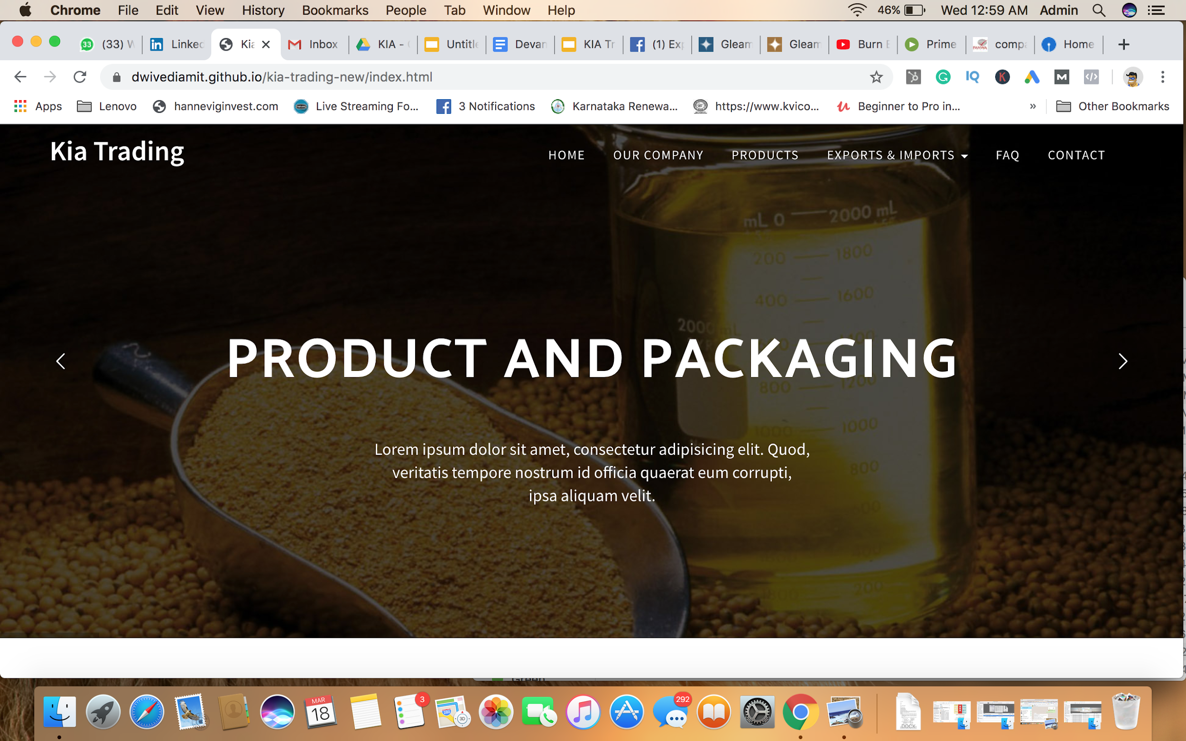
Please add more attractive image like Gleam Products The Slider Should Read 1. Quality and Accreditation
2. Globally Trusted
3. Best Price
*Need to Add ( Certifications )

Slide 2
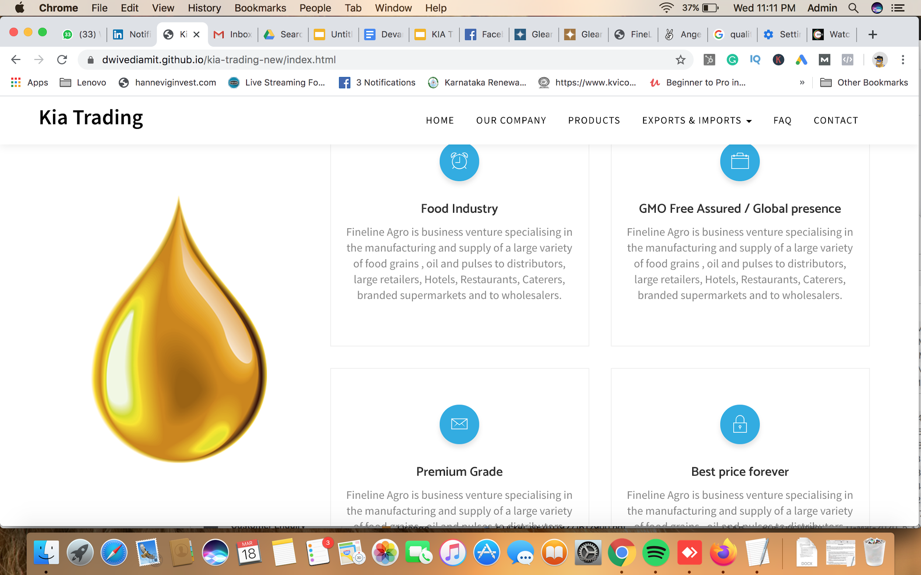
Please Replace Fineline with KIA Trading

Slide 3
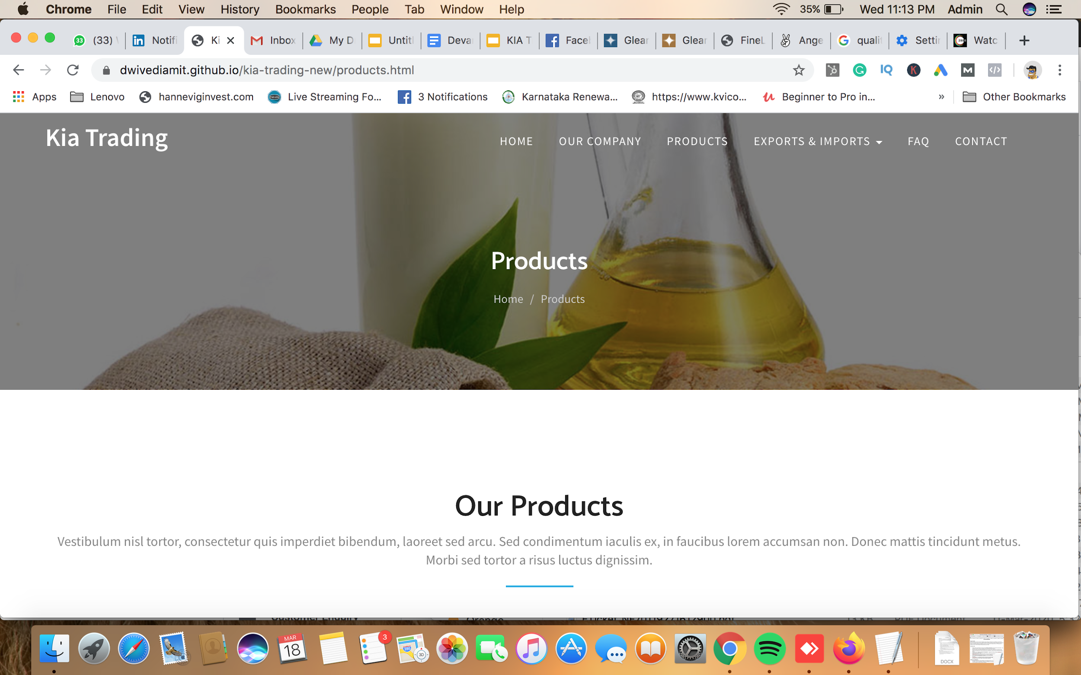
Please Add Corporate Social Responsibility (CSR) Page instead of Products

Slide 4
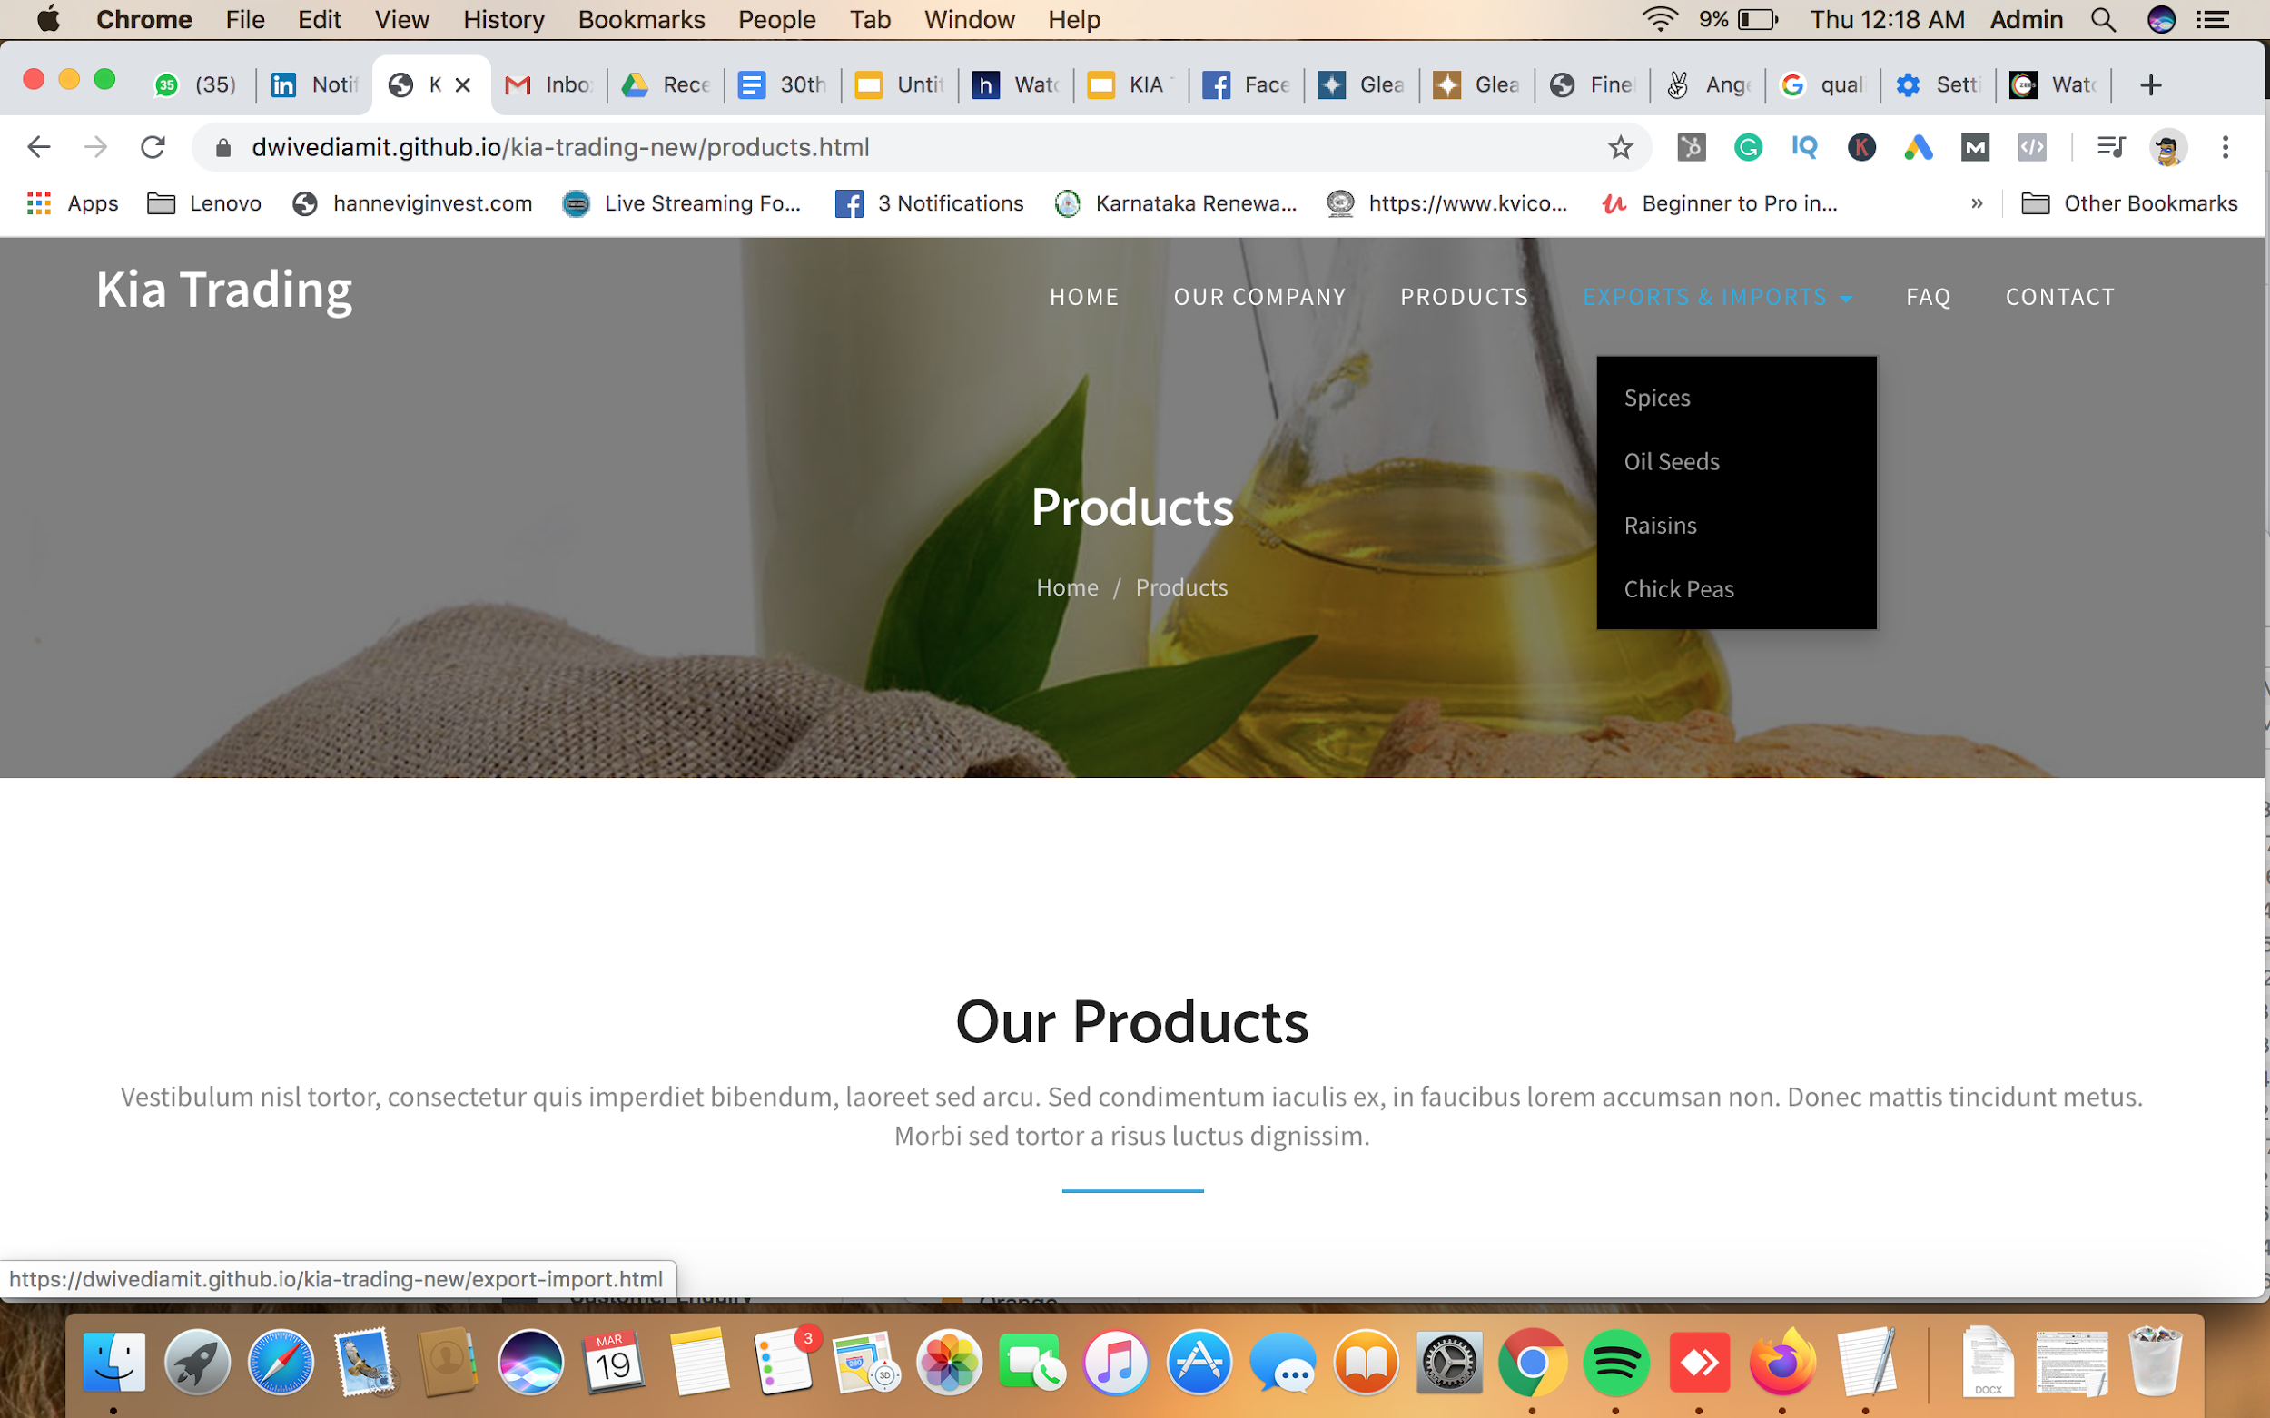
Drop downs 1. Rice 2. Spices 3. Oil 4. Pulses 5. Fruits and Vegetables 6. Green House 7. Solar

Slide 5
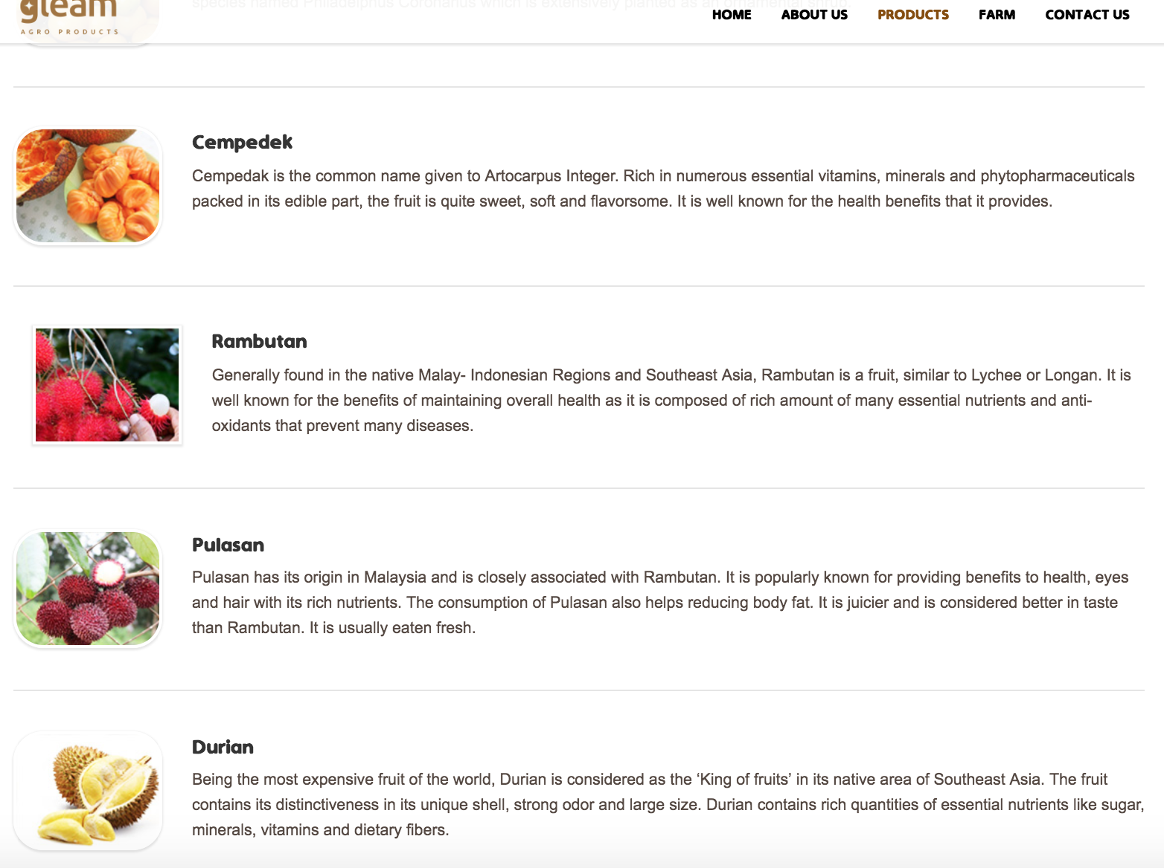
Export Listings Page ( for all the drop down )

Slide 6
Export and Import : (Will share more Details ) Rice : All types of rice Available Green Vegetables and Fruits
Sesame Seeds ( Black Thil )The black sesame seed is less common and has a more concentrated flavor than other sesame seeds. Black sesame seeds are especially good on salmon and other fish.The natural black sesame seeds which we offer are carefully cleaned. We also offer two qualities of black sesame seeds – General and Z-Black (deep black), both are color-sorted and hence does not include white seeds Sesame Seeds ( White Thil )We export different grades of Hulled sesame seed in terms of purity 99.98%, 99.95% & premium quality exports with certification of free from microbiological organism. Mechanically hulled and mechanically dried sesame seed consists of the hulled seed from the plant sesame indicum L. The colour is white. Odour and taste are typical, and free from foreign odour and taste, such as mustiness or rancidity. Purity 99.95% Min & 99.98% Premium Quality Salmonella Absent in 25 grams Yeast & Moulds < 1 0,000 CFU/ gram TPC < 1 ,00,000 CFU/ gram F. F. A. (as oleic acid) <2%

Slide 7
Chick Peas Chick Peas has been widely acclaimed due to its tasteful flavour. We export chickpeas which is cleaned and processed before packing and transporting. Only the best of grains of pulses are selected and processed to the clients so that the taste of the food can remain authentic.
Oil (For Import ) Soybean Oil Soybean oil is a vegetable oil extracted from the seeds of the soybean (Glycine max). It is one of the most widely consumed cooking oils. Per 100 g, soybean oil has 16 g of saturated fat, 23 g of monounsaturated fat, and 58 g of polyunsaturated fat.
Palm Oil Palm oil is an edible vegetable oil derived from the mesocarp (reddish pulp) of the fruit of the oil palms, primarily the African oil palm Elaeis guineensis,^{[1]} and to a lesser extent from the American oil palm Elaeis oleifera and the maripa palm Attalea maripa.
Dal and Pulses : Soyabean :The soybean or soya bean (Glycine max)^{[3]} is a species of legume native to East Asia, widely grown for its edible bean, which has numerous uses.
Green Gram (Mung bean) The mung bean (Vigna radiata), alternatively known as the green gram, maash, or moong^{[2]} Sanskrit मुद्ग / mudga, is a plant species in the legume family.^{[3][4]} The mung bean is mainly cultivated in East Asia, Southeast Asia and Indian subcontinent. It is used as an ingredient in both savory and sweet dishes

Slide 8
Black Gram Black gram originated in India, where it has been in cultivation from ancient times and is one of the most highly prized pulses of India and Pakistan. It is very widely used in Punjabi cuisine and is often referred to as maah di daal in the native language by Punjabis. The Coastal Andhra region in Andhra Pradesh is famous for black gram. The Guntur District ranks first in Andhra Pradesh for the production of black gram. Black gram has also been introduced to other tropical areas such as the Caribbean, Fiji, Mauritius, and Africa, mainly by Indian immigrants.
Red Gram : The pigeon pea^{[1]} (Cajanus cajan) is a perennial legume from the family Fabaceae. Since its domestication in the Indian subcontinent at least 3,500 years ago, its seeds have become a common food in Asia, Africa, and Latin America. It is consumed on a very large scale in South Asia and is a major source of protein for the population of the Indian subcontinent. It is the primary accompaniment to rice or roti (flat bread) and has the status of staple diet throughout the length and breadth of India.
White Gram : Chickpea is a key ingredient in hummus and chana masala, and it can be ground into flour to make falafel. It is also used in salads, soups and stews, curry and other meal products like channa. The chickpea is important in Indian and Middle Eastern cuisine.
Kidney bean : The kidney bean is a variety of the common bean (Phaseolus vulgaris). It is named for its visual resemblance in shape and colour to a kidney.

Slide 9
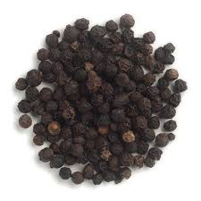
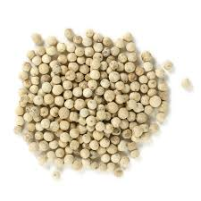
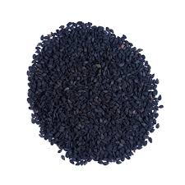
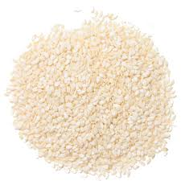
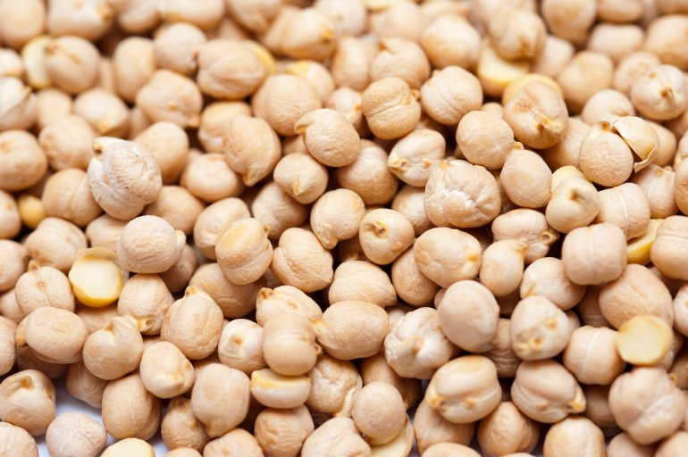
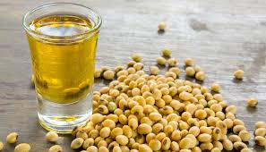
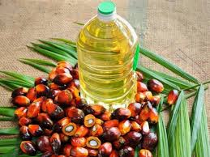
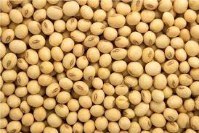
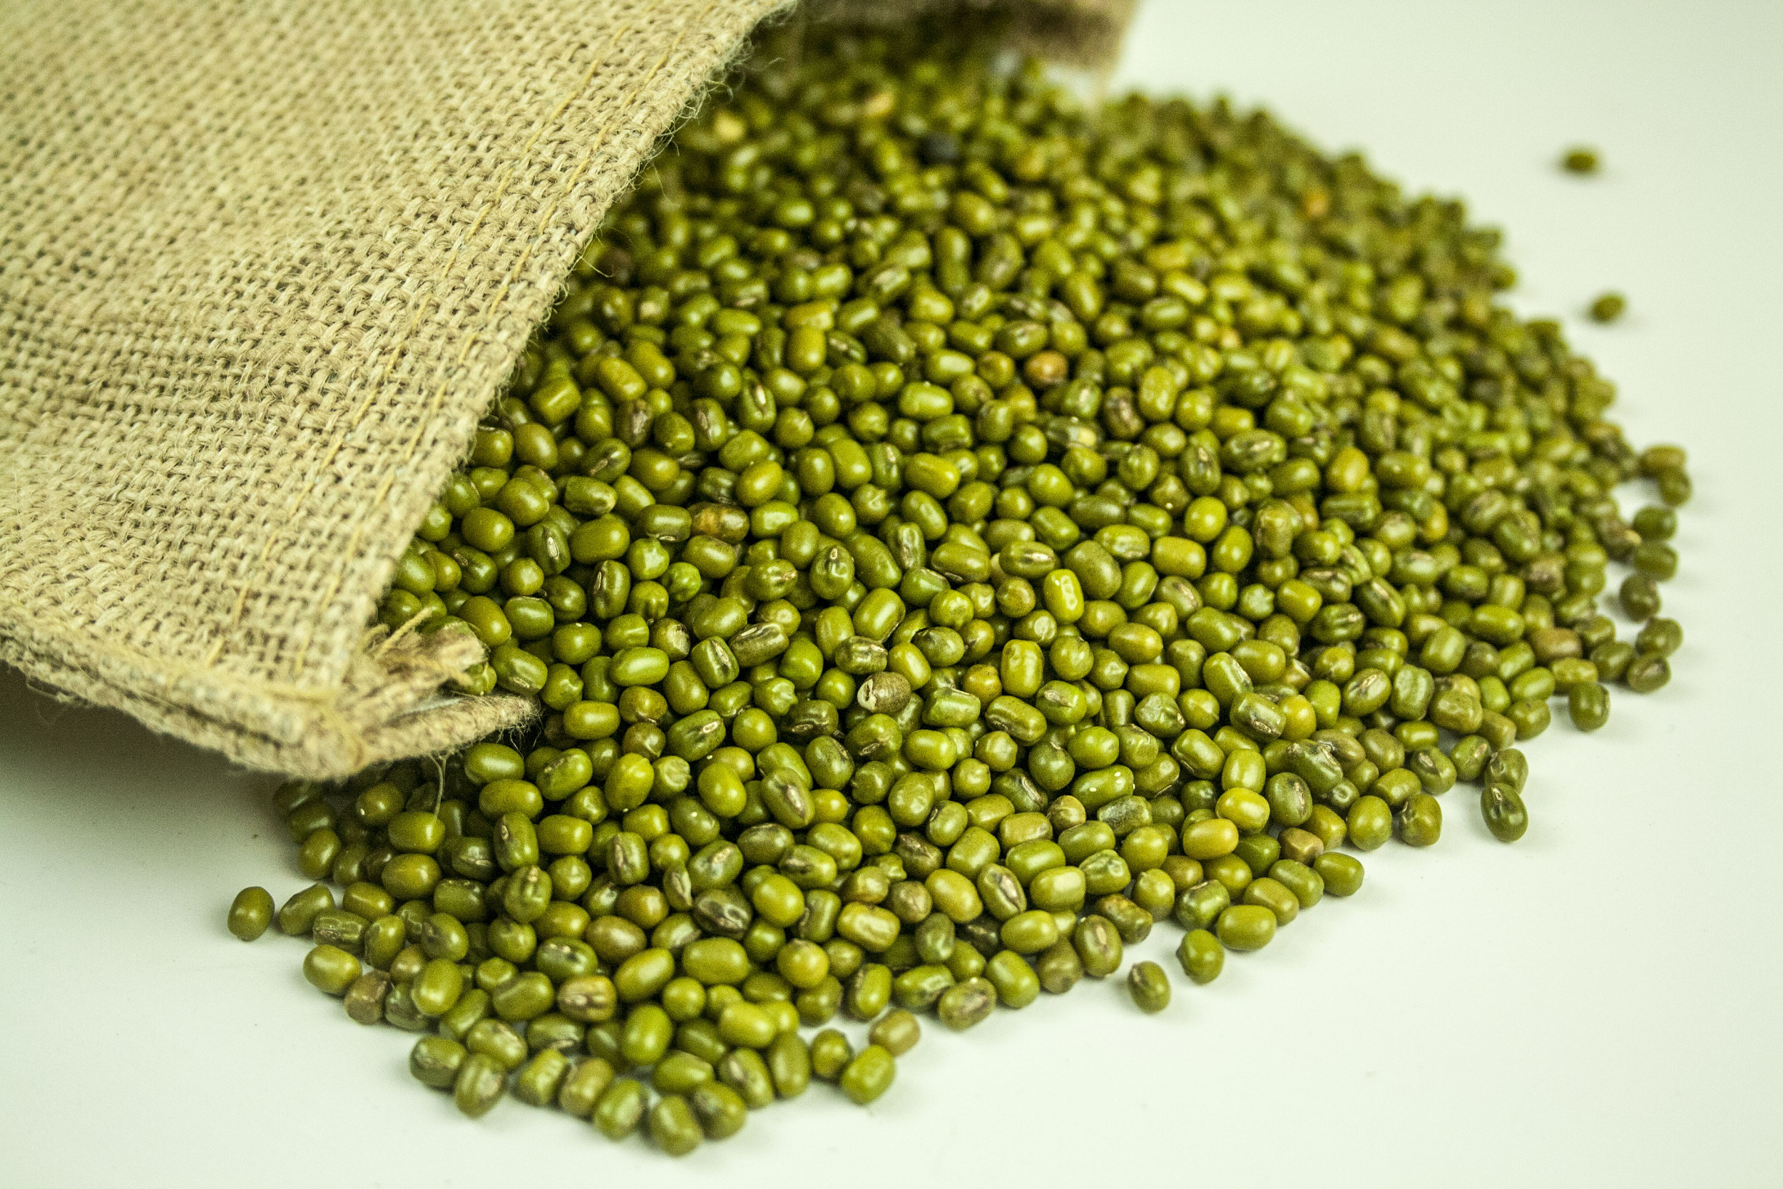
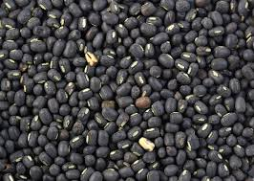
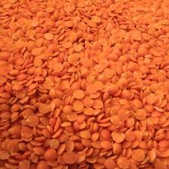
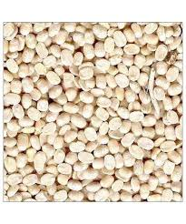
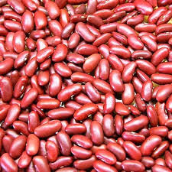
k Pepper
White Pepper
Sesame Seeds
Sesame Seeds
Chick peas :
Soyabean oil :
Palm oil :
Soyabean:
Green Gram
Black Gram :
Red Gram :
White gram
Kidney bean

Slide 10
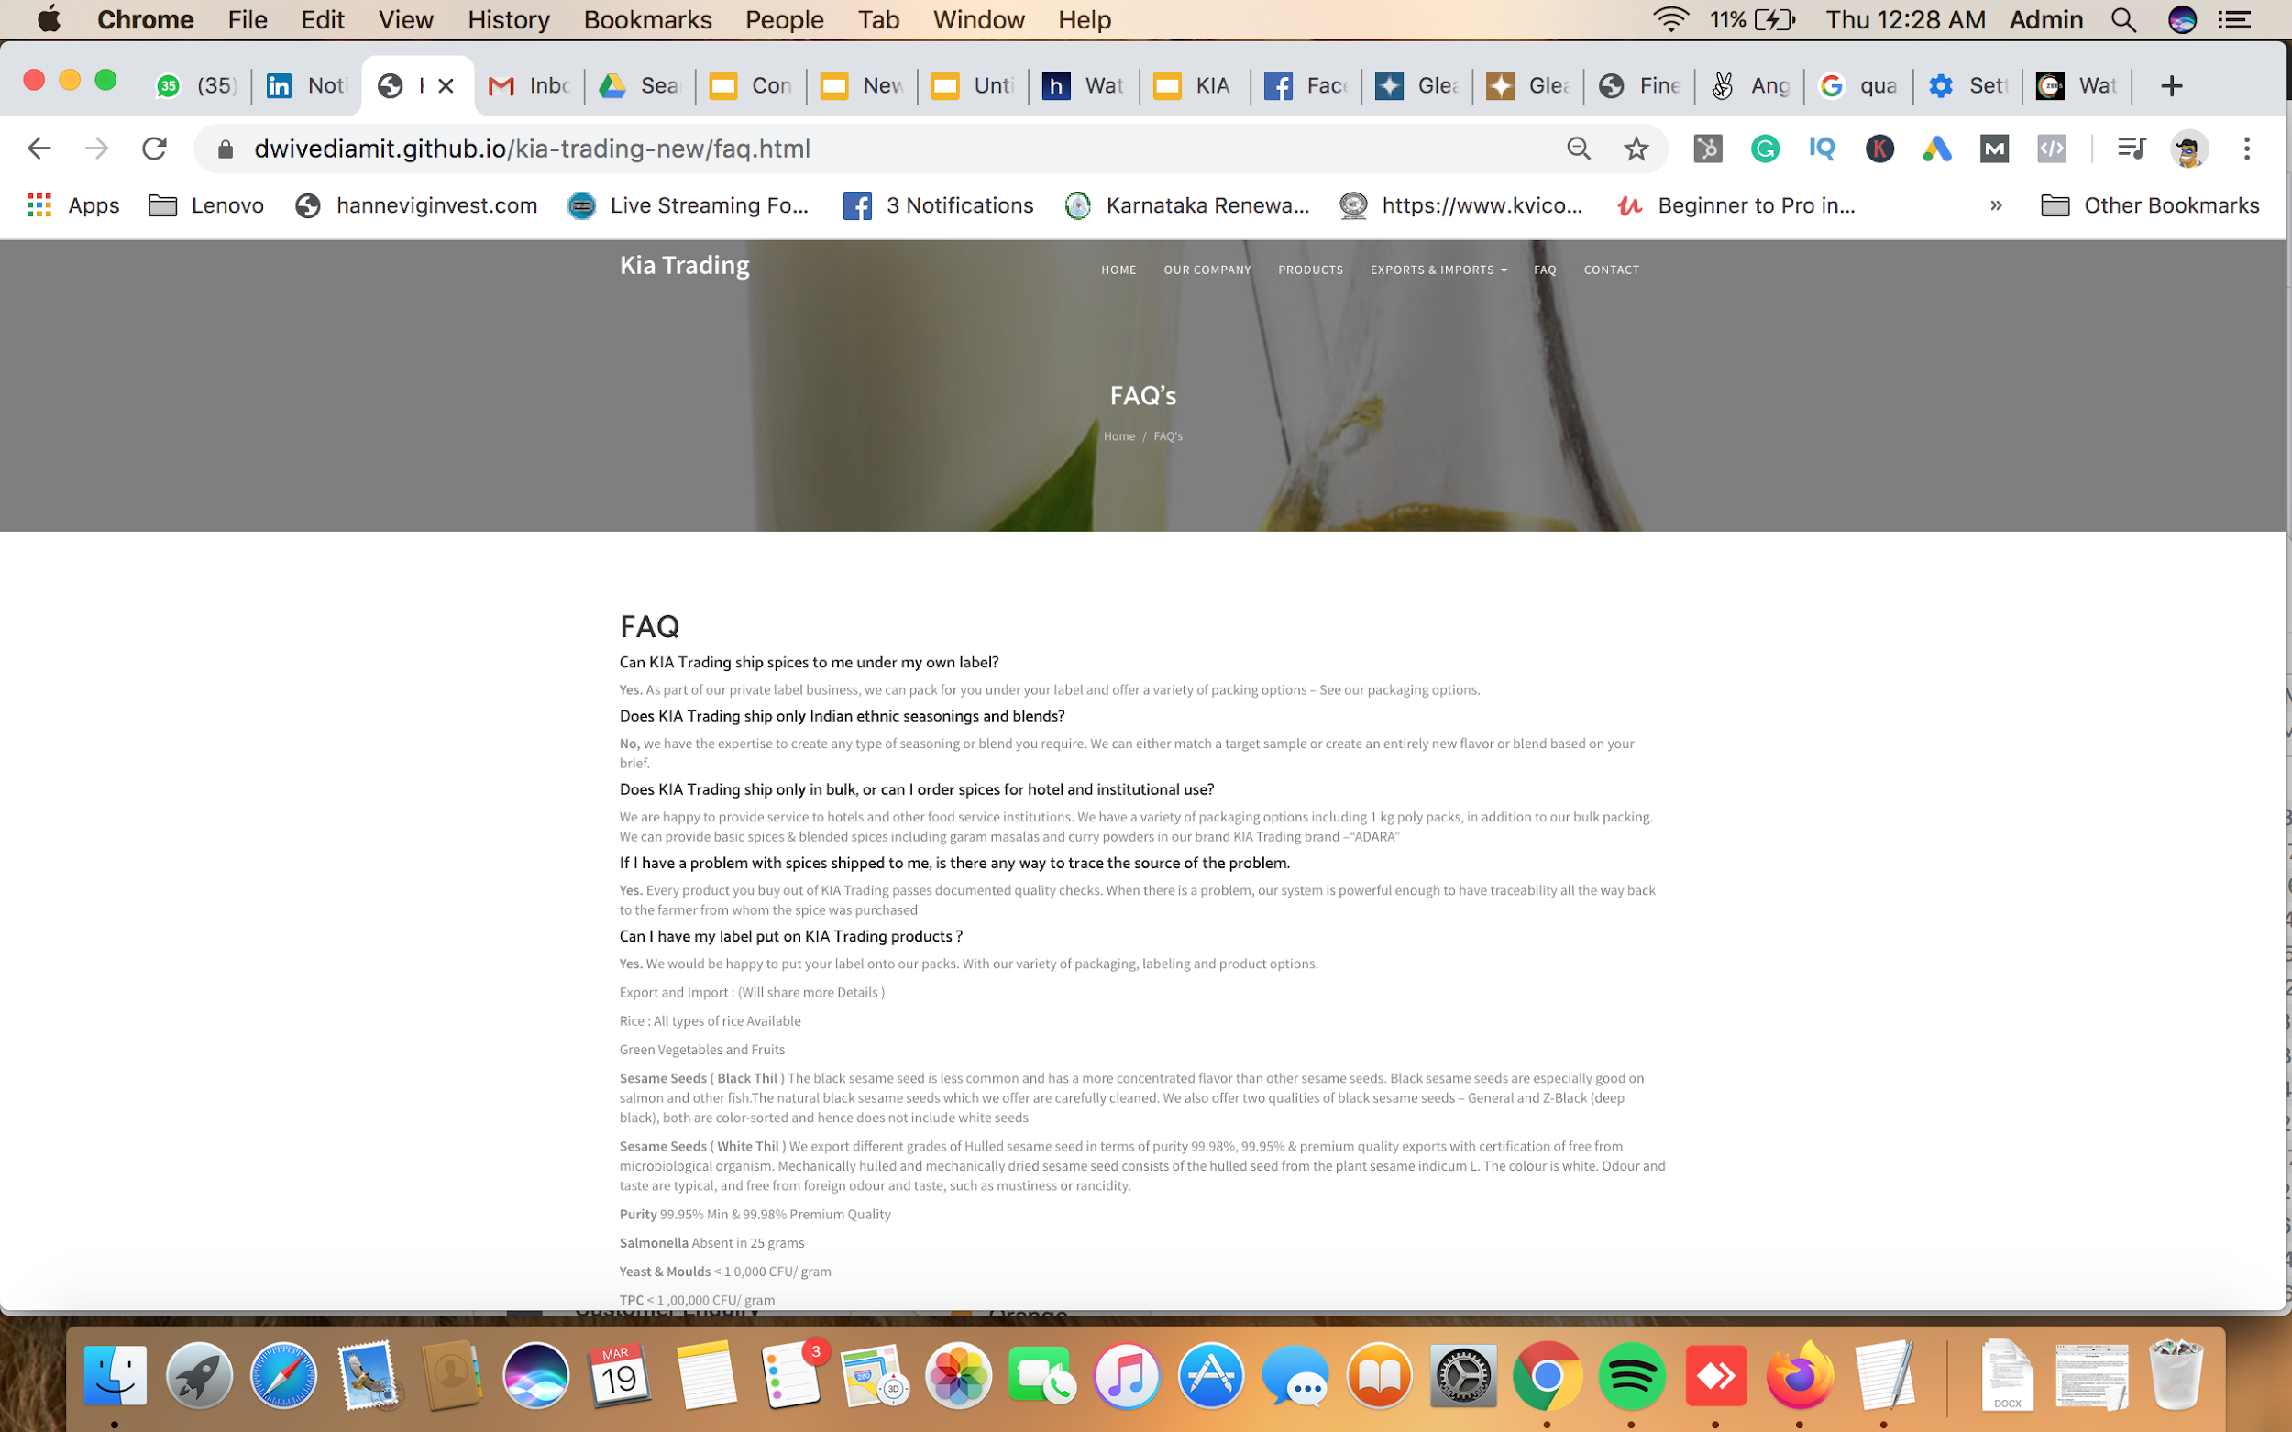
Please Note : After the Sesame Seeds the content is suppose to be in Exprt and Import Page:

Slide 11

About Us: KIA Trading is an ISO Certified , Ameda Listed, FSSAI approved, recognized by the Govt of India international exporter and importer.

Slide 12
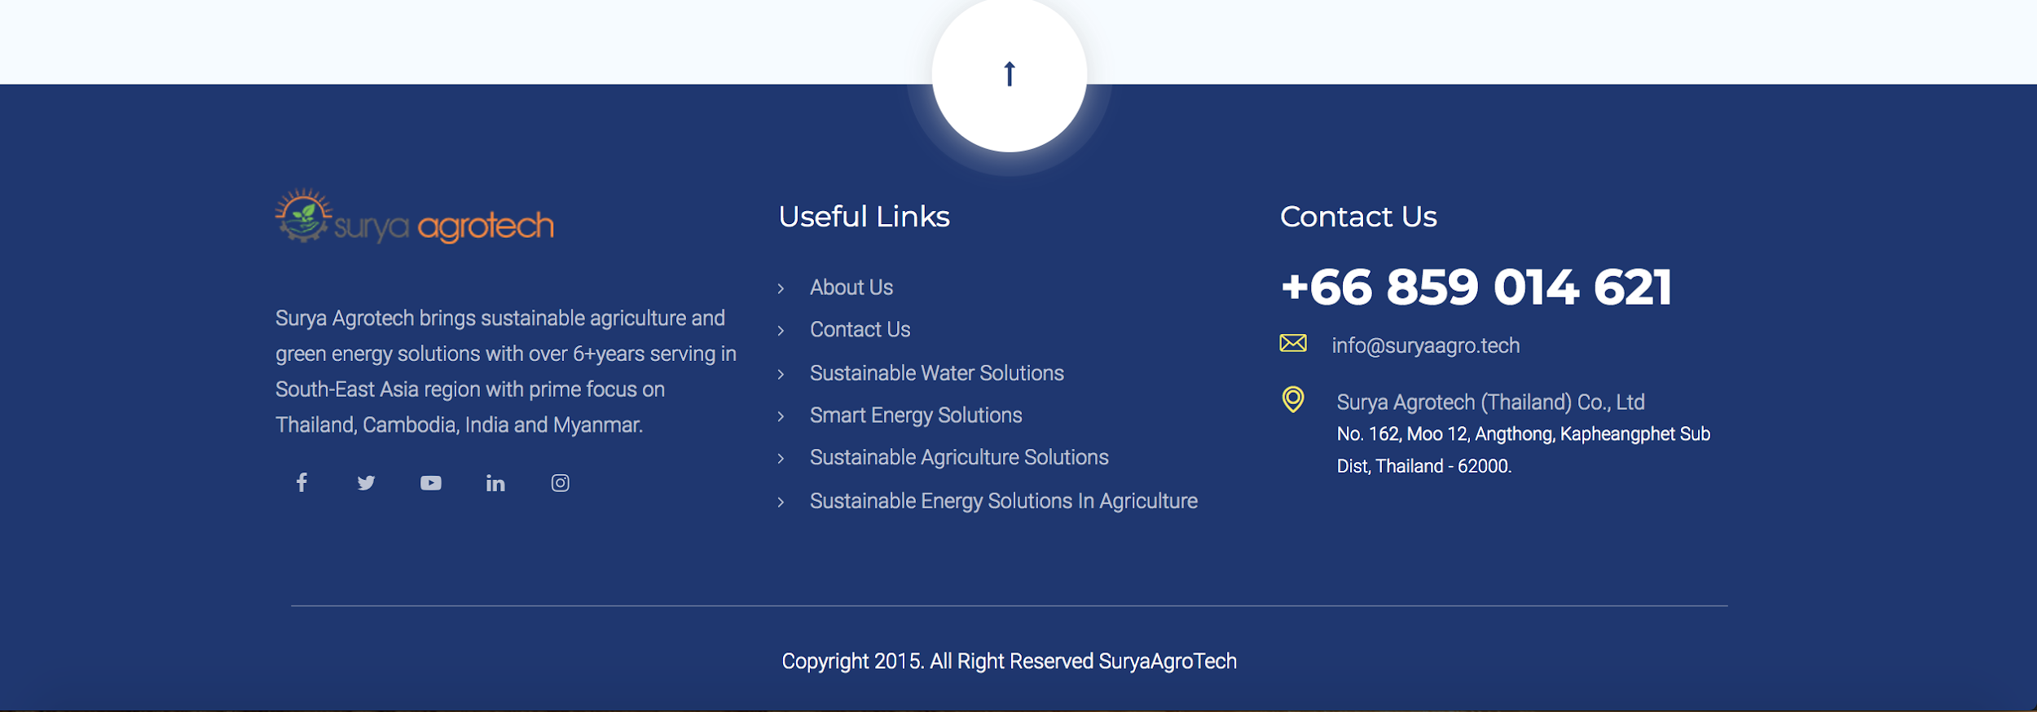
Footer Design

Slide 13
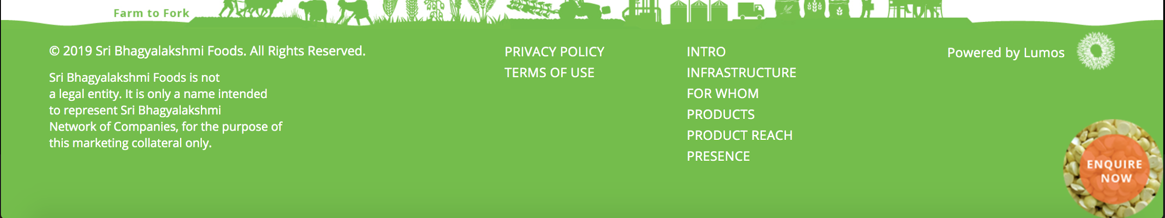
Very Similar Footers : Privacy Policy Terms of Use Useful Links Home Our Company CSR Certifications Awards Exports & Imports (We deal in) FAQ
Contact Us: KIA Trading
Myanmar
128,KIA Trading
B-8, Winsway Complex
Old Police Lane,
Andheri east
Mumbai 400069.
Near Andheri Court
Ph No: +91-
+91-
Email - customercare@kitrading.co
Facebook Linkedin Twitter Instagram

